Slide 1


CUSTOMER CHURN IN TELCO
Requirement Elicitation
GROUP ONE
GOVINDU SATHRUWAN
SHAHIK SHIYAM
ABDULLAH SHERIFFDEEN
IFFATH SALEEM
AAISHA AAMINA ANSAR

Slide 2



Overview of the project
Telco is a telecommunication company. Our group aims to analyze why the company loses customers by observing customer demographics, services, reasons for leaving, geographical area, and customer account information.
Understanding the significance of studying customer churn is crucial because acquiring a new customer in the telecommunication industry can be up to five times more costly than retaining an existing one. This makes reducing customer turnover critical for Telco, especially given the difficulty of winning back lost customers, further underscoring the importance of minimizing churn.

Slide 3



Telco Industry Overview
1. Key Players:
-Telco operates in the telecommunications industry, alongside other major players offering similar services, such as mobile, broadband, and fixed-line services. Key competitors include both global and regional telecom companies such as AT&T, Verizon, T-Mobile, Vodafone, and China Mobile.
3. Challenges:
- Telco faces challenges such as maintaining network infrastructure, high capital investments (especially for 5G), regulatory requirements, and intense competition, which can lead to price wars and slimmer profit margins. Another key challenge is reducing customer churn and maintaining customer satisfaction.
2. Market Trends:
- Telco must keep pace with trends like the deployment of 5G networks, increased demand for digital and cloud-based services, and the convergence of mobile, internet, and entertainment services into bundled offerings. Additionally, there’s a growing emphasis on sustainability and enhancing customer experience through personalized services.
As data becomes more valuable, telecom companies are focusing on analytics, customer insights, and monetization of customer data while navigating regulatory and privacy concerns.

Slide 4
What is Customer Churn?
Customer churn refers to the phenomenon where customers stop using a company’s services, either by cancelling their subscriptions or switching to a competitor. It is a critical metric in subscription-based industries like Telecommunication.
There are two types of churn, namely, Voluntary and Involuntary churn.
1. Factors Contributing to Customer Churn:
For Telco, customer churn may occur due to poor network quality, better offers from competitors, unsatisfactory customer service, pricing issues, or outdated technology. Customers may also leave if they find more attractive service bundles elsewhere or experience unresolved billing issues.
2. Impact of Churn on Telco’s Business:
Customer churn negatively affects Telco’s revenue and profitability. High churn increases customer acquisition costs, reduces the lifetime value of customers, and damages the company’s reputation. Telco must invest more in retention strategies and continually improve its offerings to reduce churn and maintain a stable customer base.

Slide 5
What is Requirement Elicitation?
Requirement Elicitation is the process of identifying and documenting the needs and requirements of the stakeholders. It’s a focused approach to requirement gathering, which involves analysing the gathered information and transforming it into specific and actionable requirements. This is a crucial step to ensure the success of the project.
Types of Requirements
1.Functional Requirements
2. Non-Functional Requirements

Slide 6
1.Functional Requirements
This is what the model, system or project actually achieve. These requirements are precise and aim to solve the business problem.
In this project, functional requirements could be:
Discover patterns and trends between churn reasons and customer demographics to identify which type of customers leave due to which type of problems.
Discover patterns and trends between churn reasons and different services Telco provided to these churned customers to identify which of Telco’s services has failed to retain customers and for what reason.
Provide suggestions on potential solutions to the identified problems.

Slide 7
2. Non-Functional Requirements
This is how the model, system or project performs to achieve its functional requirements. It aims to make the solution practical, scalable, and efficient.
In this project, non-functional requirements could be:
The research findings and recommendations must be presented clearly and in an accessible manner with the help of visual aids, i.e. charts and graphs.
The report should be written in a way that is understandable to stakeholders at Telco who may not have deep technical knowledge.
The project must ensure that customer data used in the research is anonymized and complies with ethical standards, particularly around privacy and confidentiality.
The project must also ensure that any sampling done on the dataset is carried out without any bias.

Slide 8



STAKEHOLDERS
Internal
Shareholders- Reduced customer churn would lead to higher growth and Profit for Telco hence incentivising shareholders to further invest.
Customer service representatives- Representatives have to be aware of different customer demographics and how to tackle them.
IT personnel- Telco provides several services such as Television browsing, internet service access and SIM issuance. These will have to be kept up to date in order to meet customer expectation levels.
External
Customers- The issue faced by Telco is customer churn which clearly indicates that important facilities are lacking or have not been provided and attended to as soon as possible. Some common services they could look into include better service coverage, after sales and updated service

Slide 9
Elicitation Techniques
Elicitation Techniques are certain ways used in order to obtain information or data from elsewhere, mainly through conversations and dialogues. Below are certain techniques
1. Interviews
Structured interviews:
Structured interviews are a direct form of interviewing candidates, it can help solve direct problems a business has identified.
Unstructured interviews:
Unlike structured interviews these interview methods are much more open and can bring in confidence in participants. This method of interviewing can help businesses identify problems that they have not identified due to the discovery of unidentified information.
2. Surveys
This is a method of gathering information by making use of documents with questions given towards a group of people who represent the population as a whole. There are two types of surveys, online based and paper based surveys.
Sample survey questions can be used as these questions are designed in certain ways to meet a goal. In our instance it would be to lower customer churn.

Slide 10
Elicitation Techniques
3. Observation:
It is a method used to analyse customers in their natural environment and how they would go about in their day to day lives. (eg: data consumption of customers for certain packages. Call frequency etc)
4. Document analysis:
Reviewing existing documents (e.g., contracts, customer data):
This method basically makes use of secondary data. It can give a business different ways of understanding from different standpoints. It can also increase confidence in our decision-making as these data are verified and validated.

Slide 11
Key Challenges Faced By Telco
Communication Gaps:
Issue: Different departments interpret churn metrics variably, causing misalignment.
Impact: This leads to inconsistent models, affecting decision-making and customer retention.
Ambiguous or Conflicting Requirements:
Issue: Stakeholder requirements may be unclear or conflicting, especially regarding "churned" customers.
Impact: Ambiguity can result in inaccurate churn models, causing misestimation of churn rates.
Changing Priorities:
Issue: The fast-paced telco industry leads to shifting customer behaviors and business goals.
Impact: Constant updates to churn models are necessary, potentially causing delays and rework if mismanaged.

Slide 12
Best Practices to Overcome Challenges
Active Listening
Hold one-on-one discussions or cross-department workshops to clarify objectives and definitions, such as what constitutes customer churn.
This helps to avoid miscommunication, ensuring that all teams are aligned on the key factors affecting churn.
Effective Communication
Develop a shared glossary of churn-related terms (e.g., inactivity period, voluntary churn, involuntary churn) to foster a common understanding.
This ensures that all teams, including technical and business units, are unified, reducing confusion and enhancing the accuracy of churn models.
Continuous Validation
Establish review checkpoints during the model development process, involving key stakeholders to reassess churn metrics.
This prevents rework and misalignment by catching evolving priorities early, guaranteeing that models remain adaptable and precise.
Version Control
Implement version control tools to track changes to churn definitions, thresholds, and priorities, ensuring all teams have access to the latest updates.
This avoids confusion stemming from outdated requirements or assumptions, fostering smooth collaboration among departments.

Slide 13
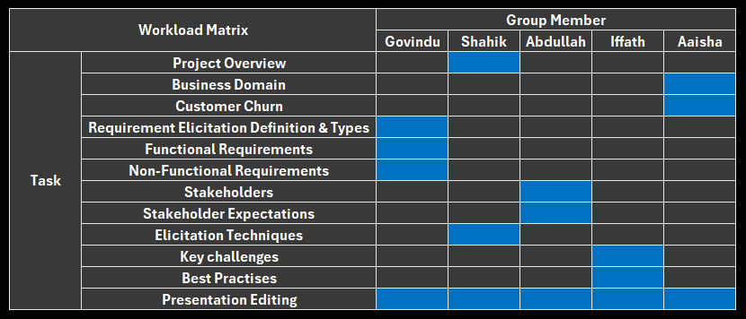
Workload Matrix

Slide 14
THANK YOU!

